Slide 1




WALMART
DATA ANALYSIS
Presented by: Uttam Batch: MIP-DA-13

Slide 2



Objective
To analyse and derive insights from Walmart's sales data to improve business decision-
making processes.

Slide 3


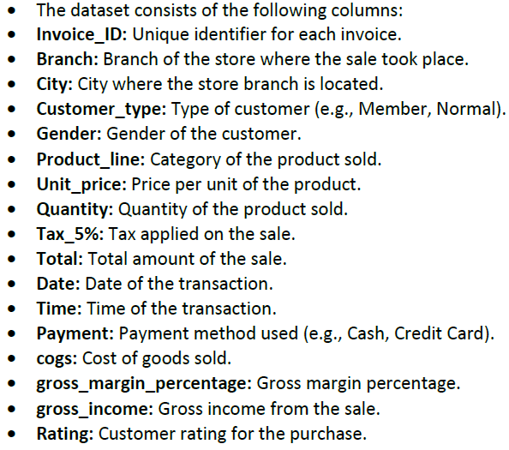
Dataset

Slide 4


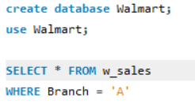
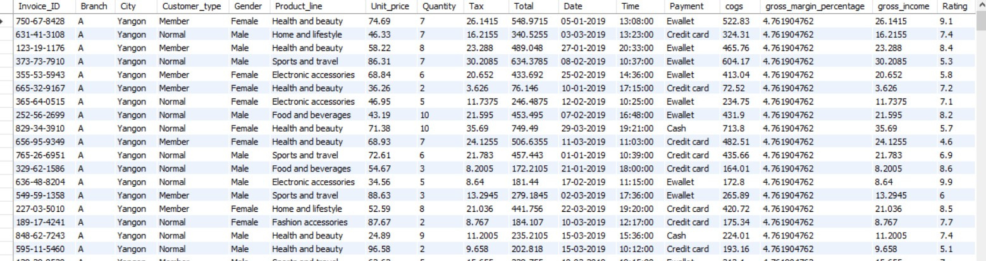

Sales Analysis
Retrieve all columns for sales made in a specific branch (e.g., Branch 'A').
01

Slide 5

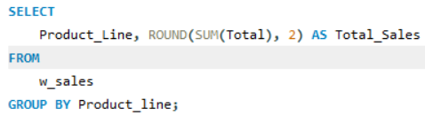
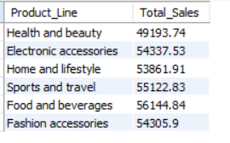
Sales Analysis
02
Find the total sales for each product line.

Slide 6

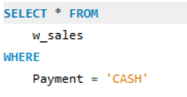
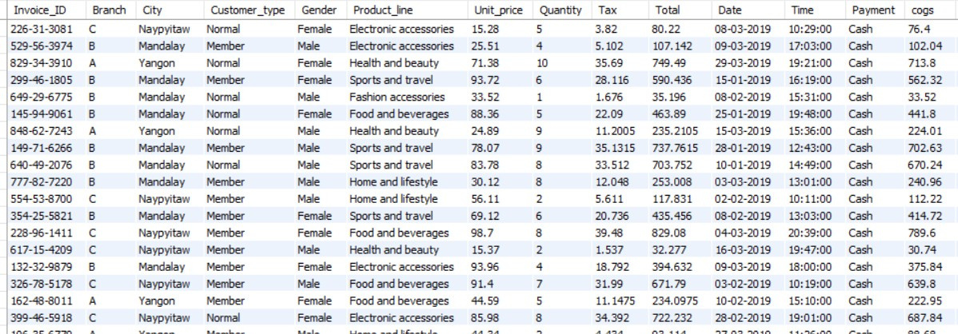
Sales Analysis
03
List all sales transactions where
the payment method was 'Cash'.

Slide 7


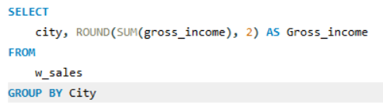
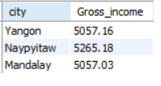
Sales Analysis
04
Calculate the total gross income
generated in each city.

Slide 8


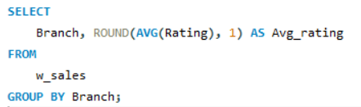
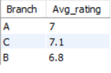

Sales Analysis
05
Find the average rating given by customers in each branch.

Slide 9
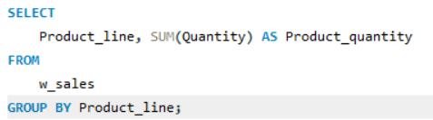
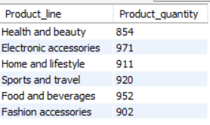
Sales Analysis
06
Determine the total quantity of each product line sold.

Slide 10
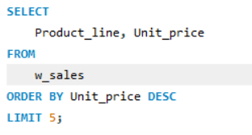
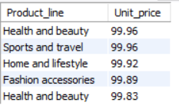
Sales Analysis
07
List the top 5 products by unit price.

Slide 11
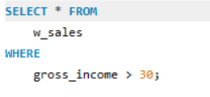
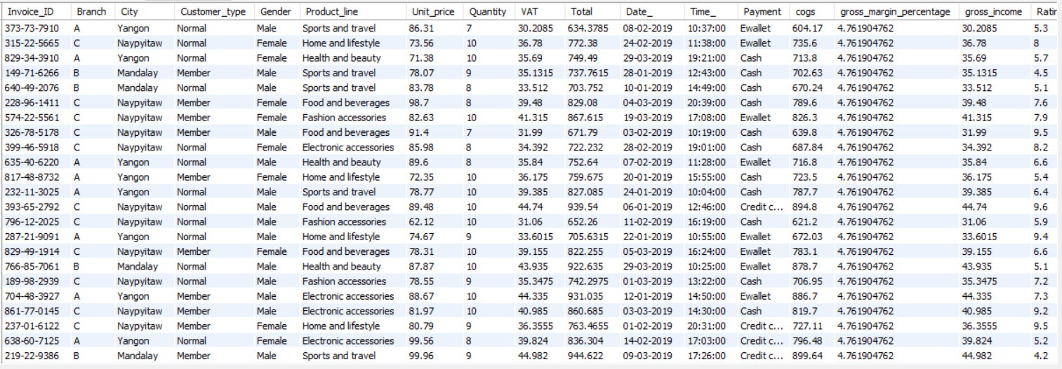
Sales Analysis
08
Find sales transactions with a gross income greater than 30.

Slide 12
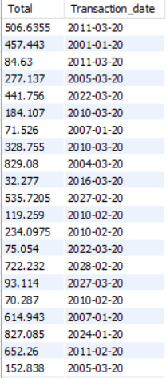
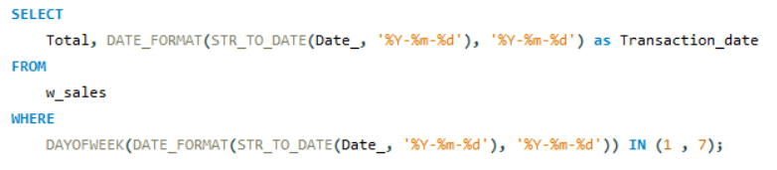
Sales Analysis
09
Retrieve sales transactions that occurred on weekends.

Slide 13
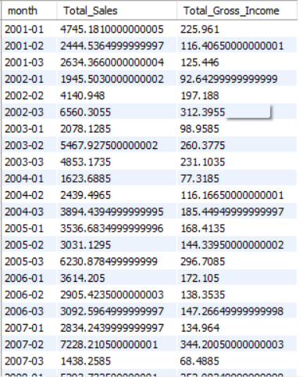
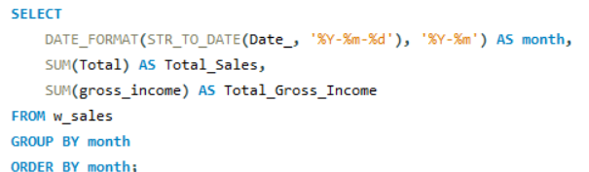
Sales Analysis
Calculate the total sales and gross income for each city and each month.
10

Slide 14
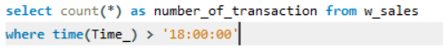
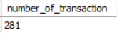
Sales Analysis
11
Find the number of sales transactions that occurred after 6 PM.

Slide 15
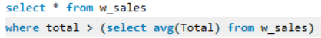
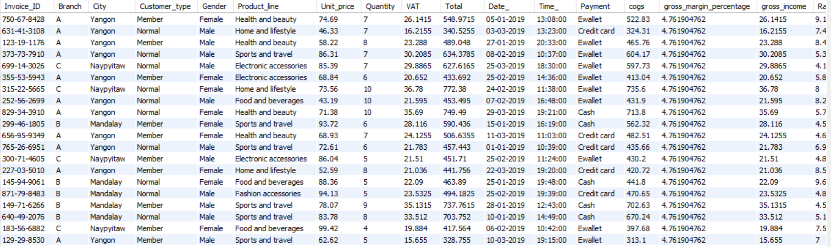
Sales Analysis
12
List the sales transactions that have a higher total than the average total of all transactions.

Slide 16
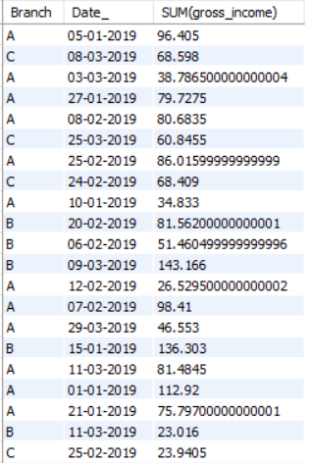
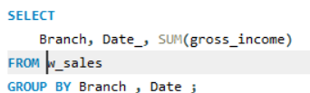
Sales Analysis
13
Calculate the cumulative gross income for each branch by date.

Slide 17
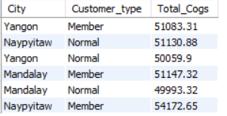
Sales Analysis
Find the total cogs for each customer type in each city.
14

Slide 18

Insights
Naypyitaw has highest total cogs value.
Food and beverages has the maximum total sales.
Number of transactions occurred after 6PM is 281
Number of quantities sold for the electronic accessories is the highest(971)
Branch C has highest average rating by Customers.
Naypyitaw city has highest total gross income.
WALMART

Slide 19


THANK YOU!

